Slide 1
PORTFOLIO WEBSITE – FINAL PROJECT
omaraziz.co.uk
OMAR AZIZ
DATE: DECEMBER 2023

Slide 2
SETTING THE GOALS
What is the purpose of the website? – Allow me to introduce myself…
What needs or requirements am I trying to fulfil. – Showcase myself and my skillset.
What the structure and layout of the site? – check this YouTube vid!
What is the vibe I want to go for? – Professional yet not overbearing
When some come interacts with the website what is it I want them to do? – Hire me for a project

Slide 3
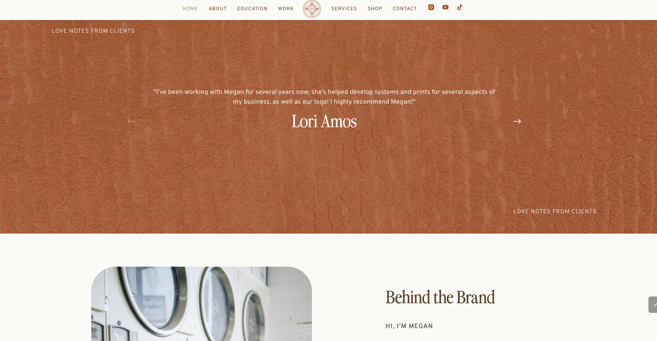
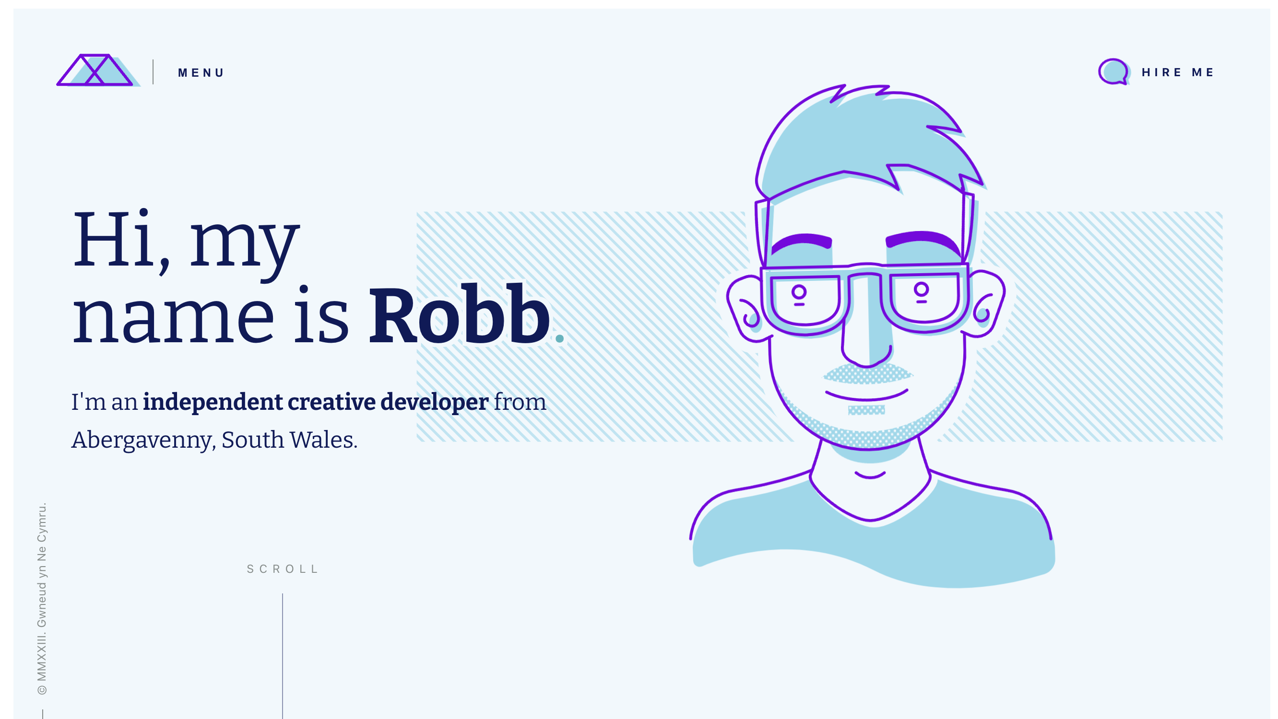
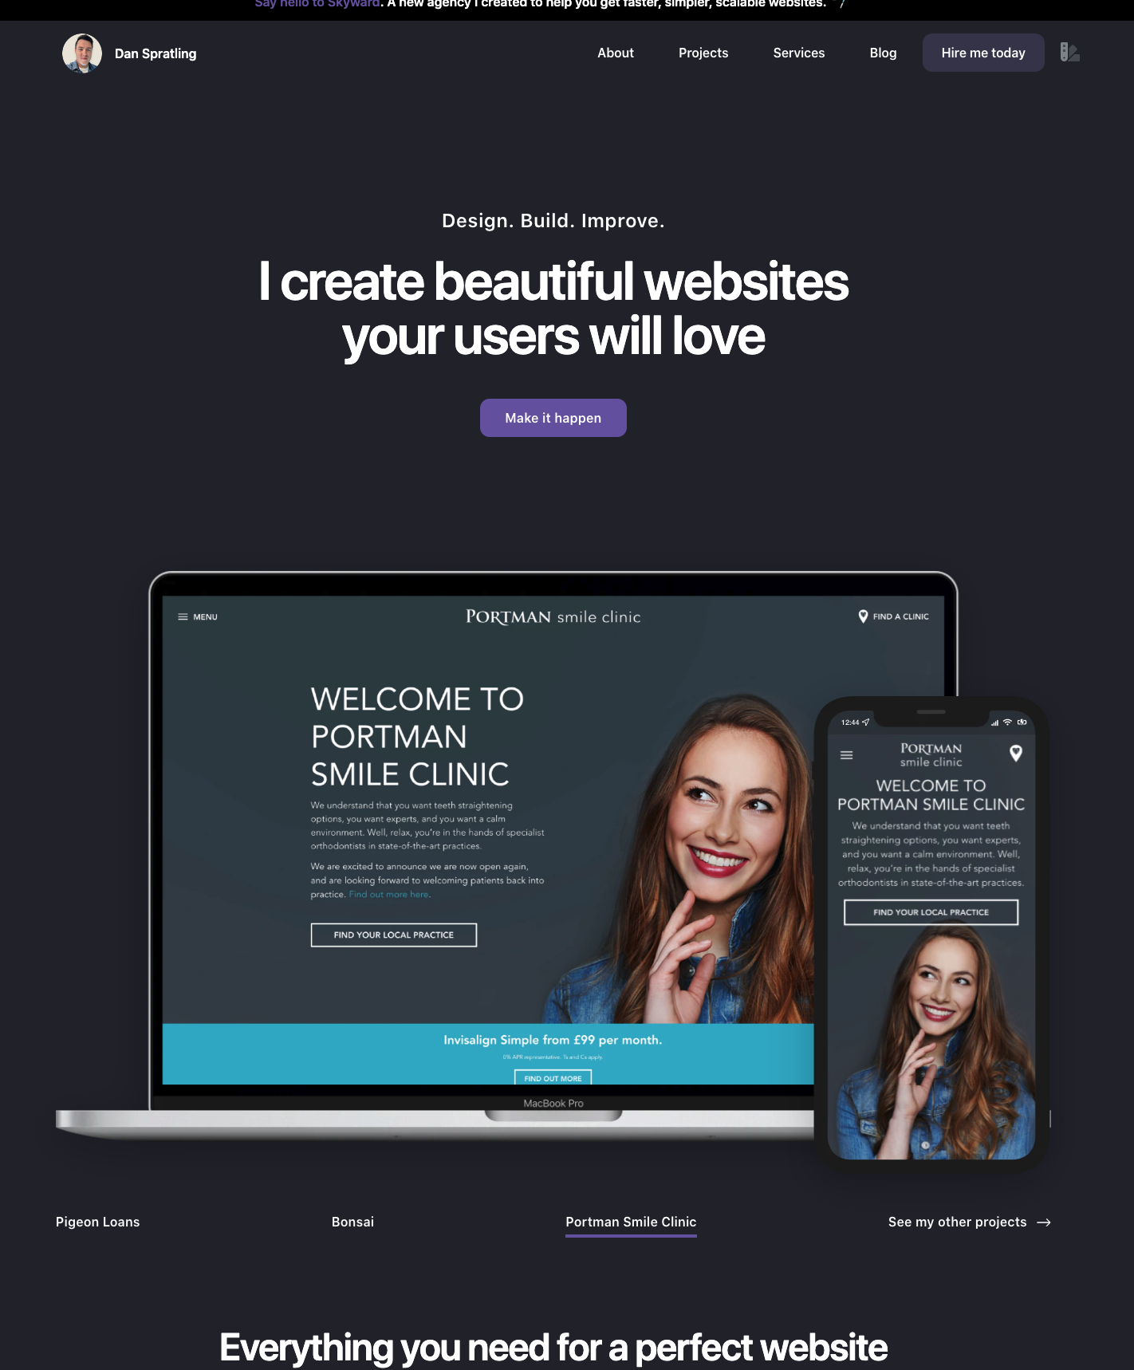
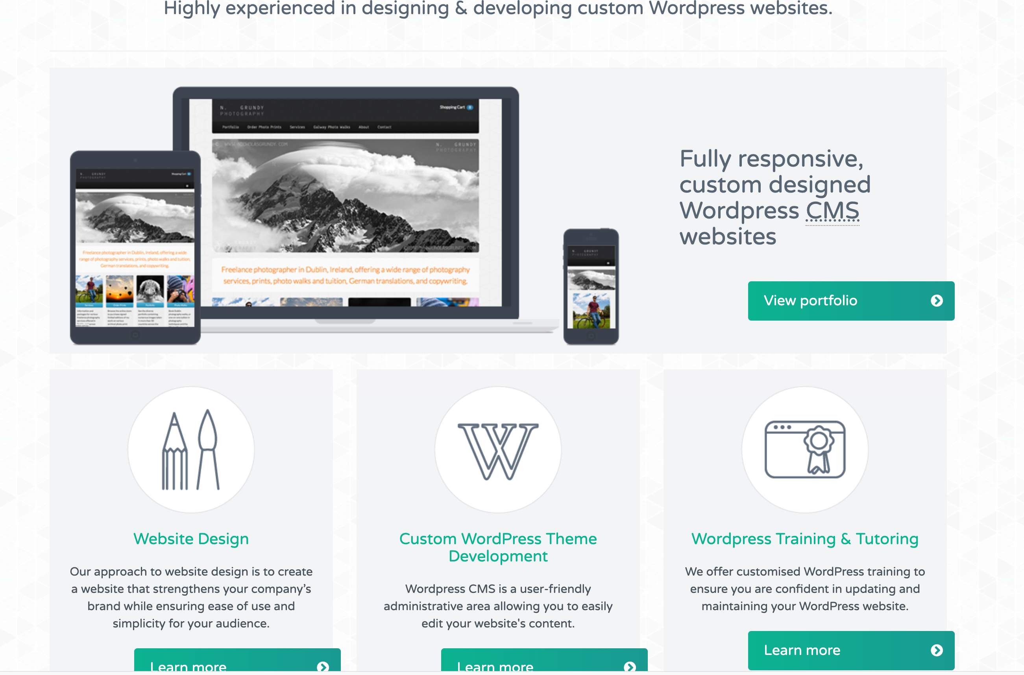
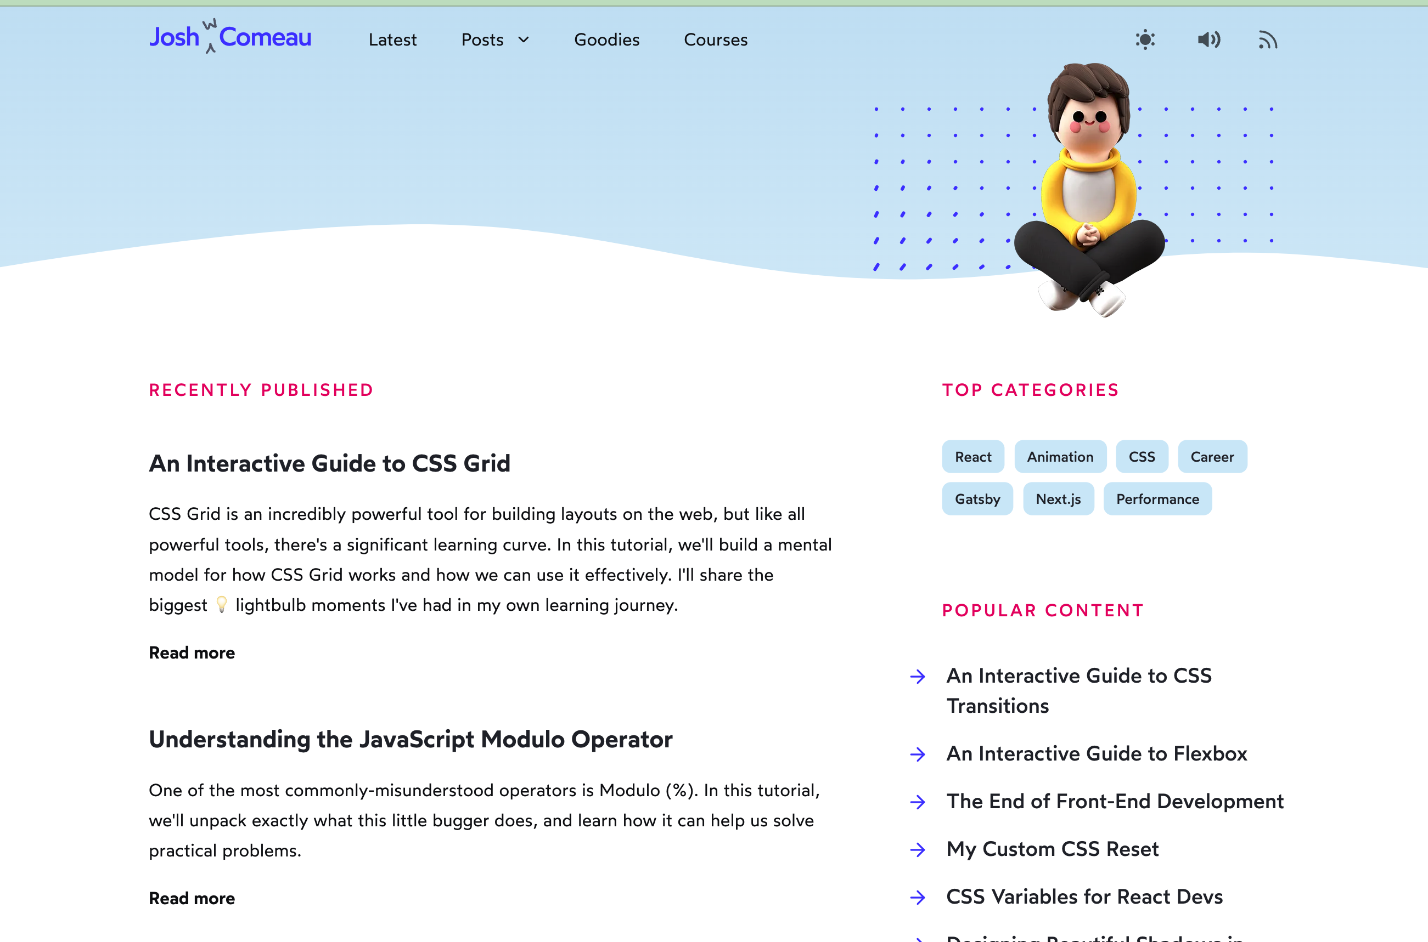
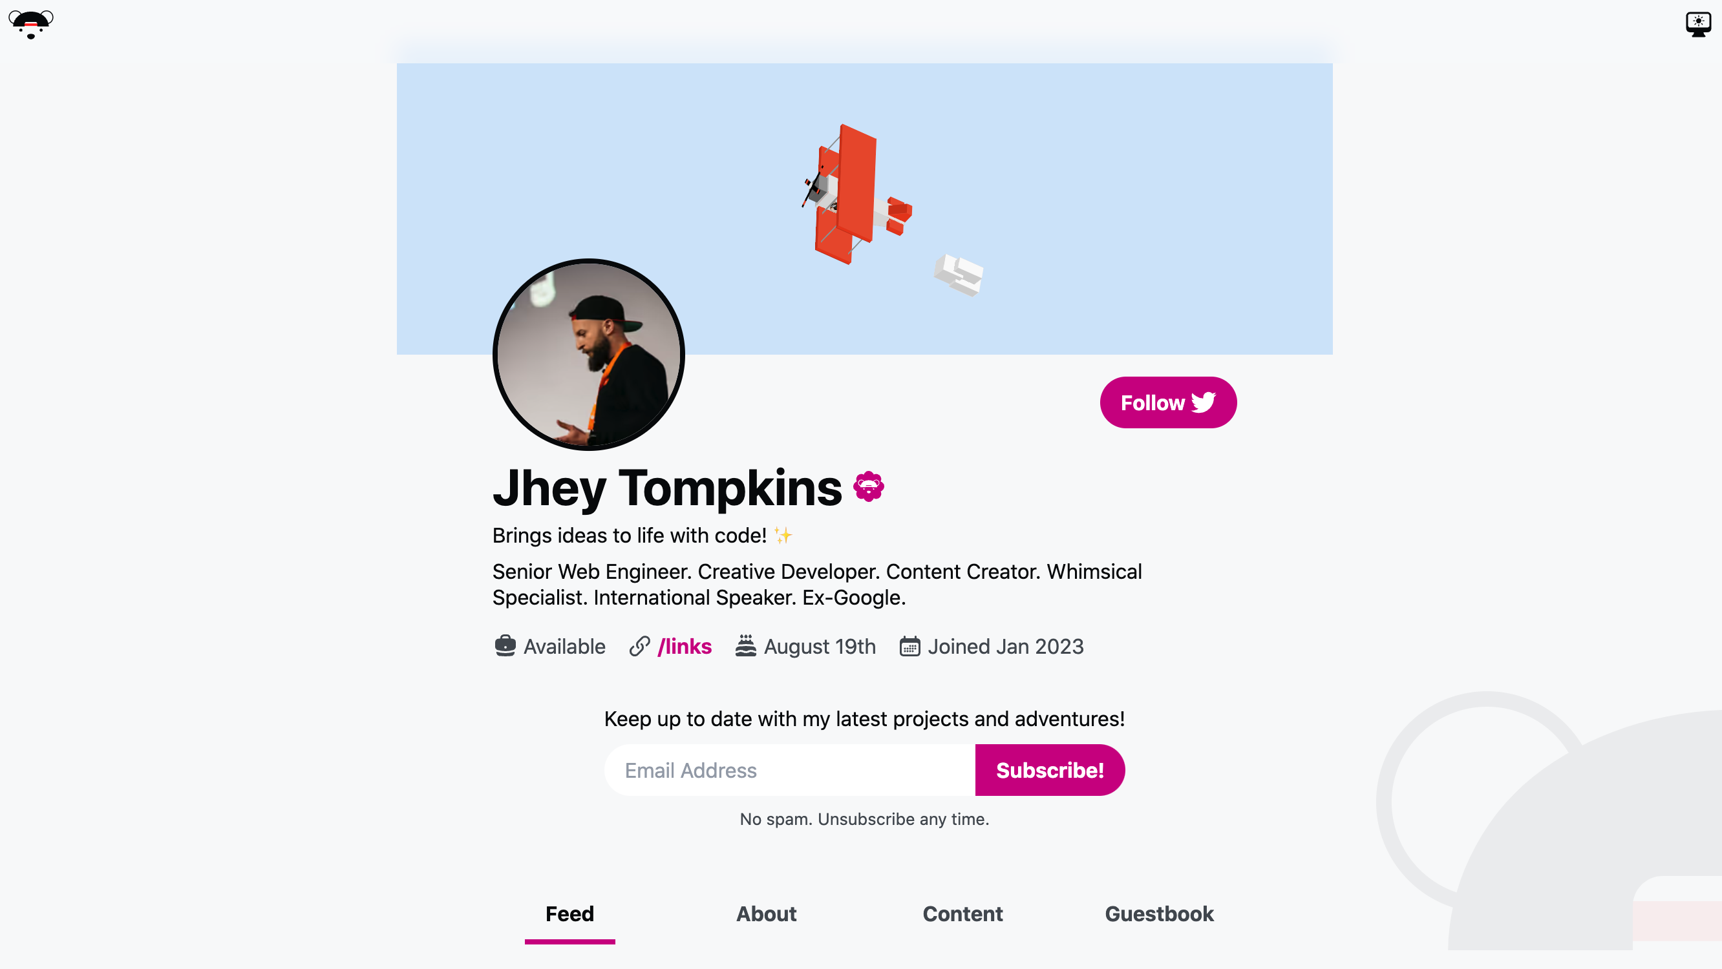
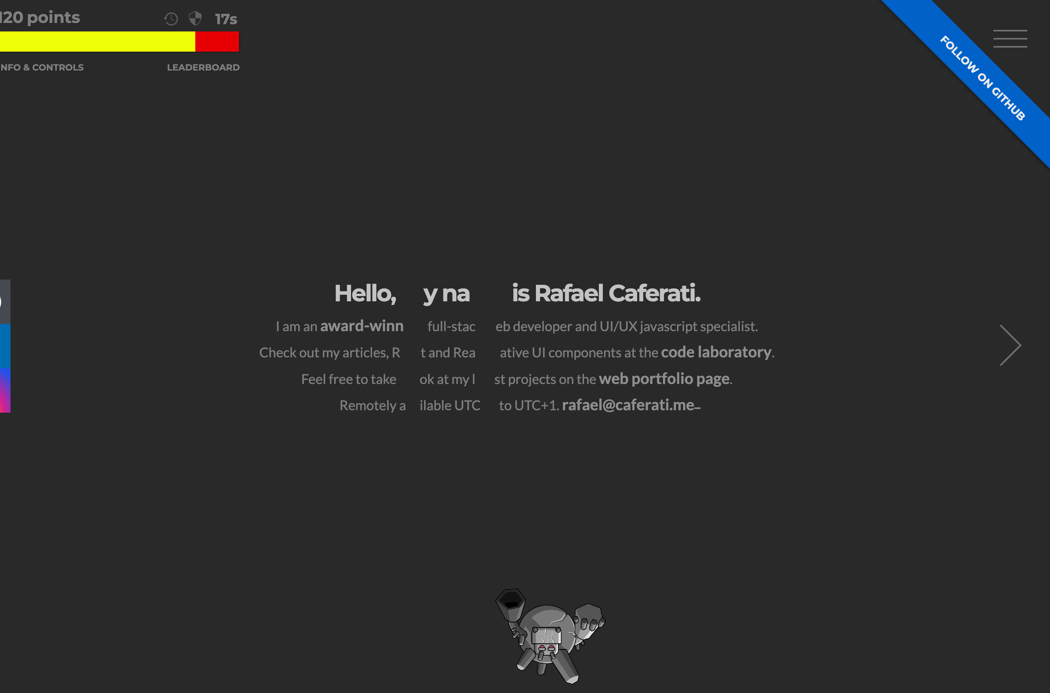
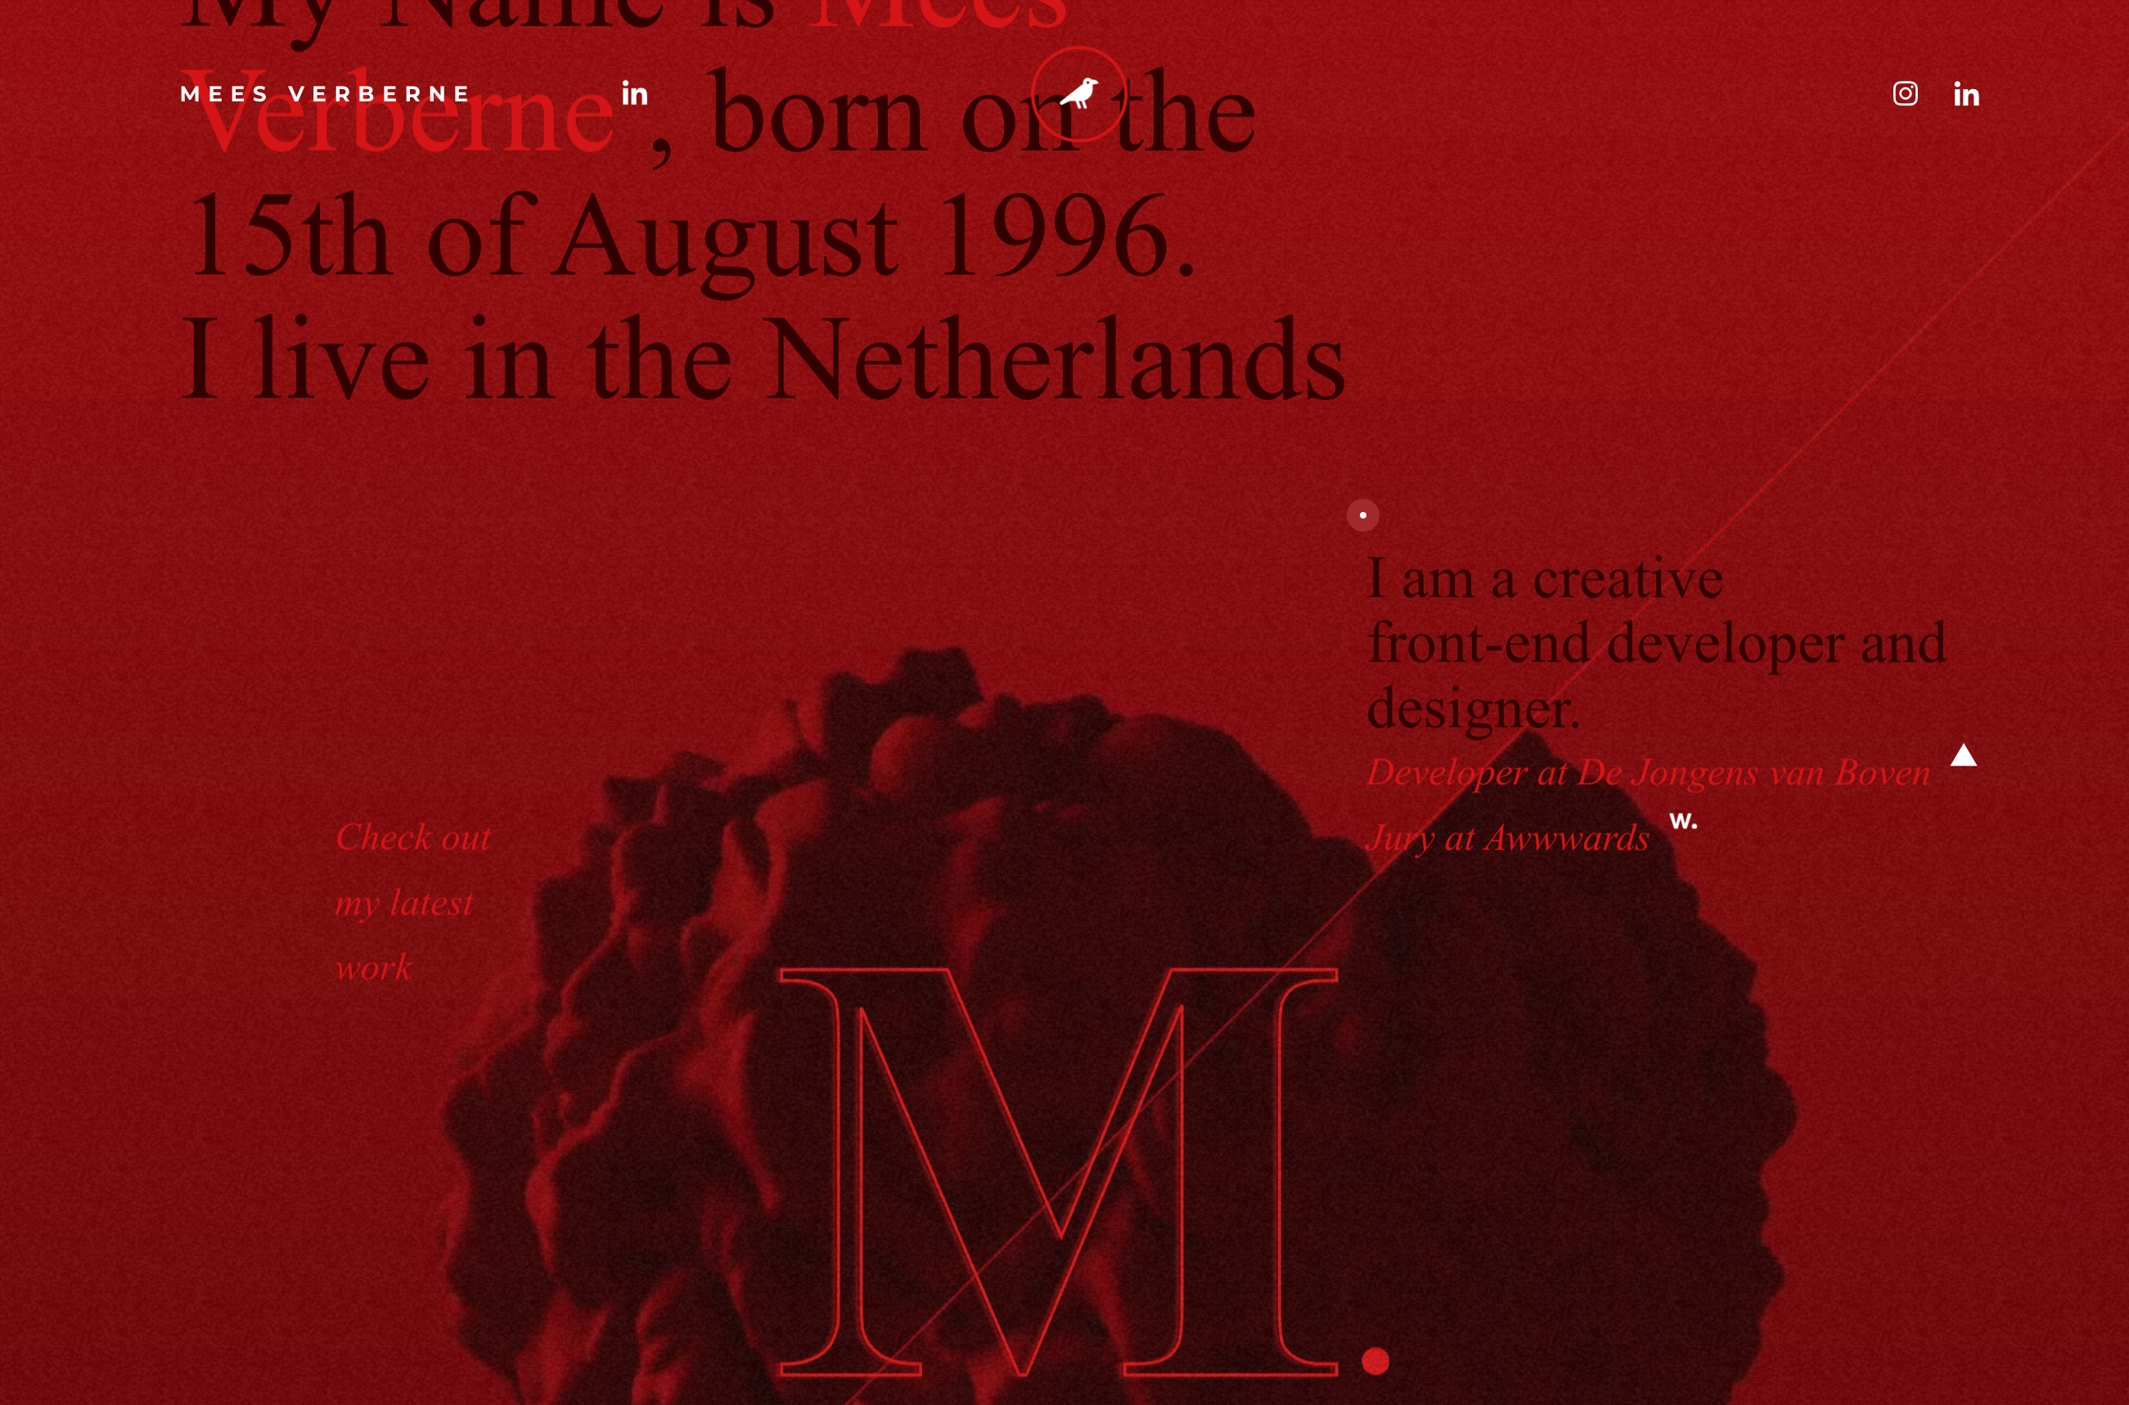
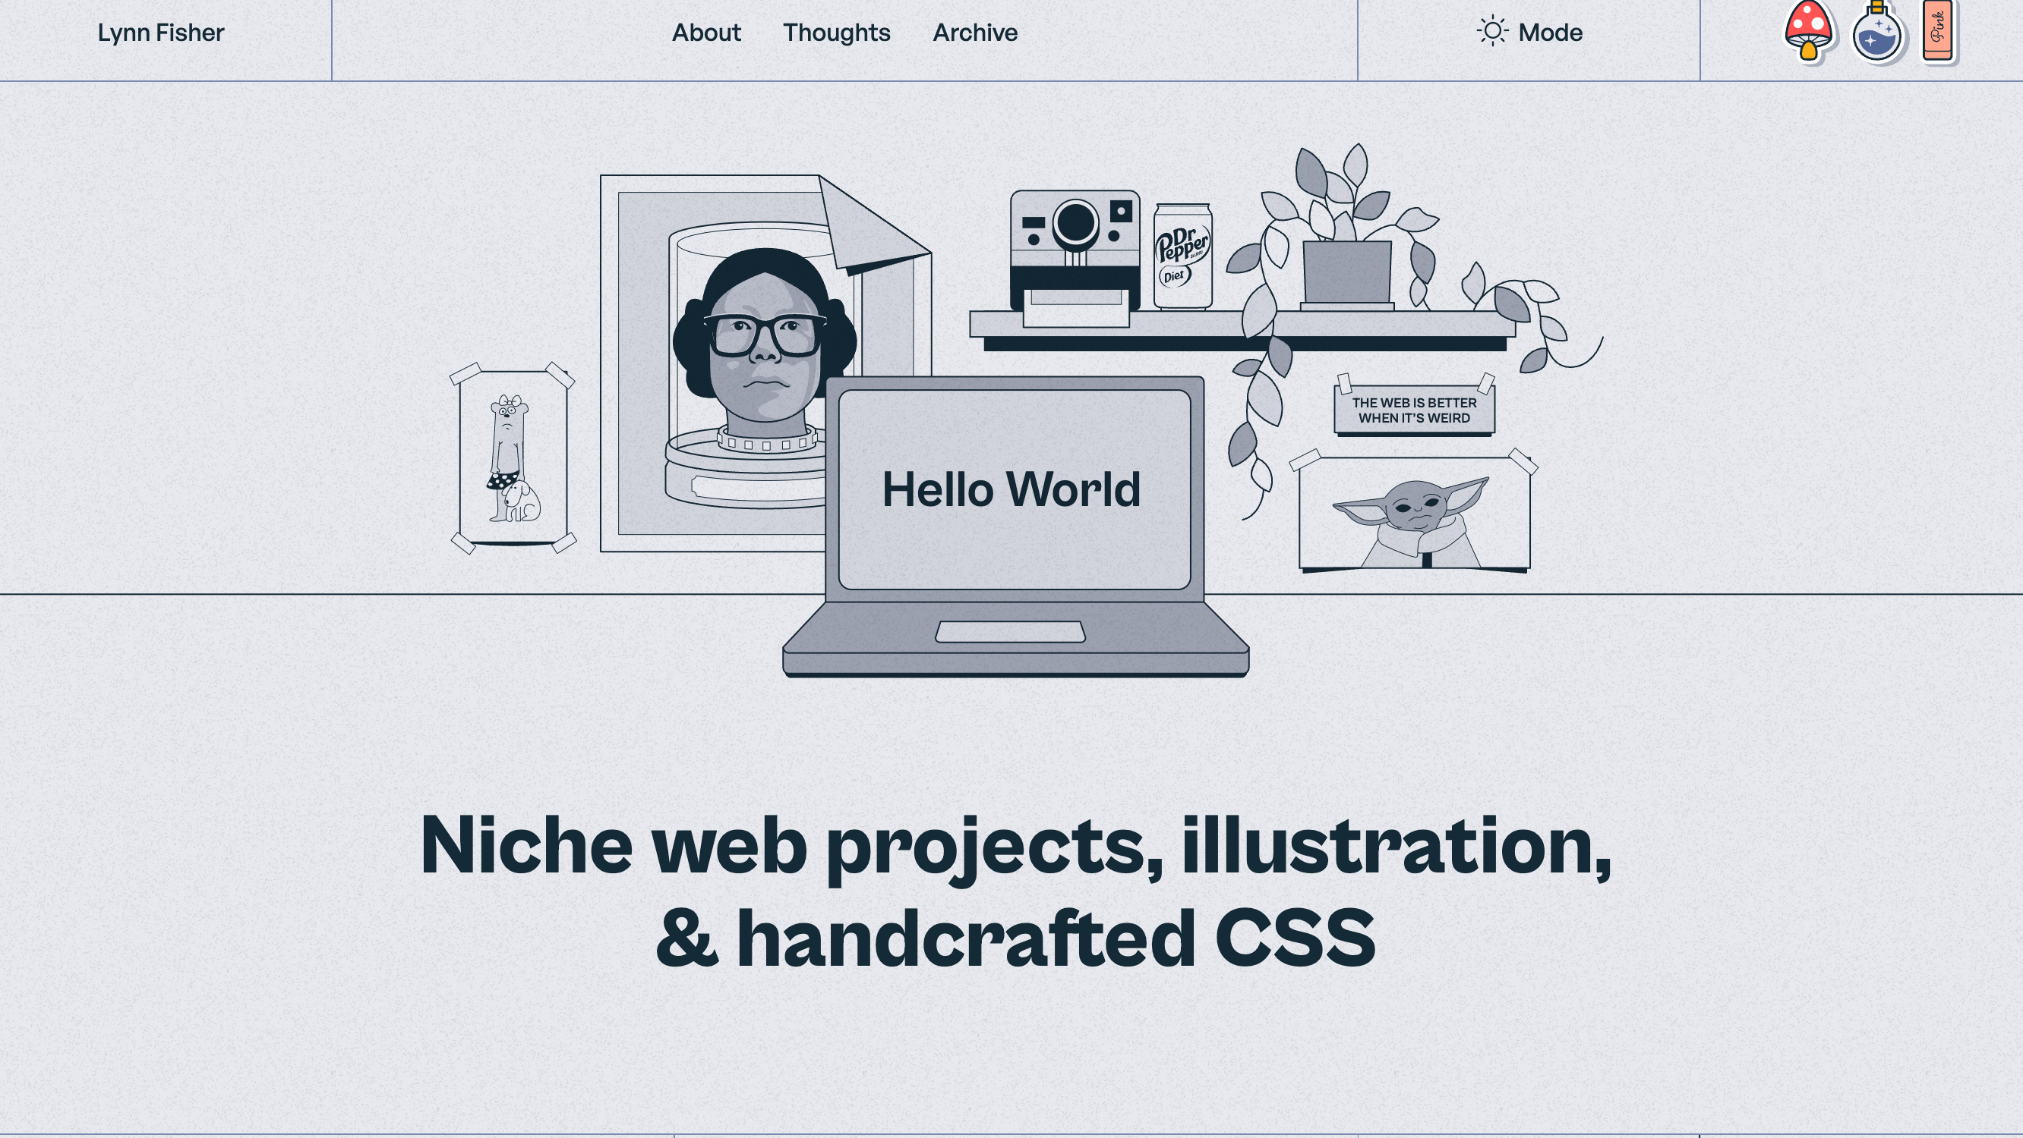
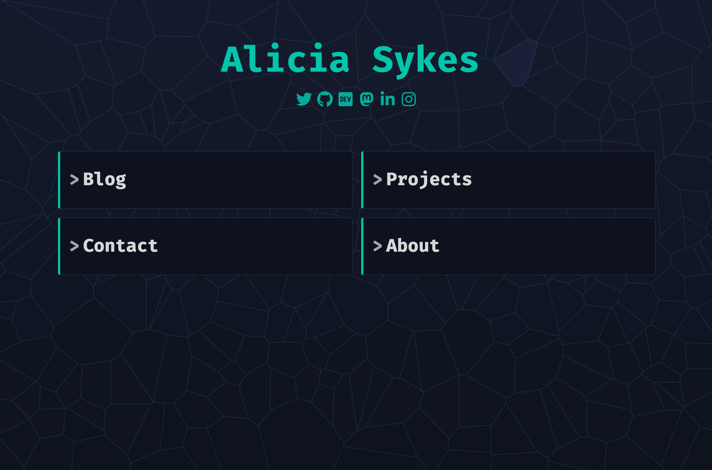
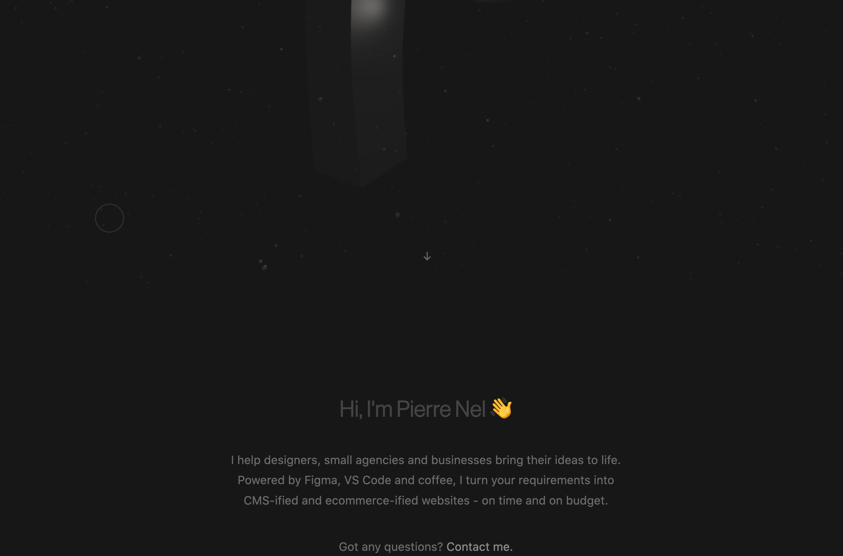
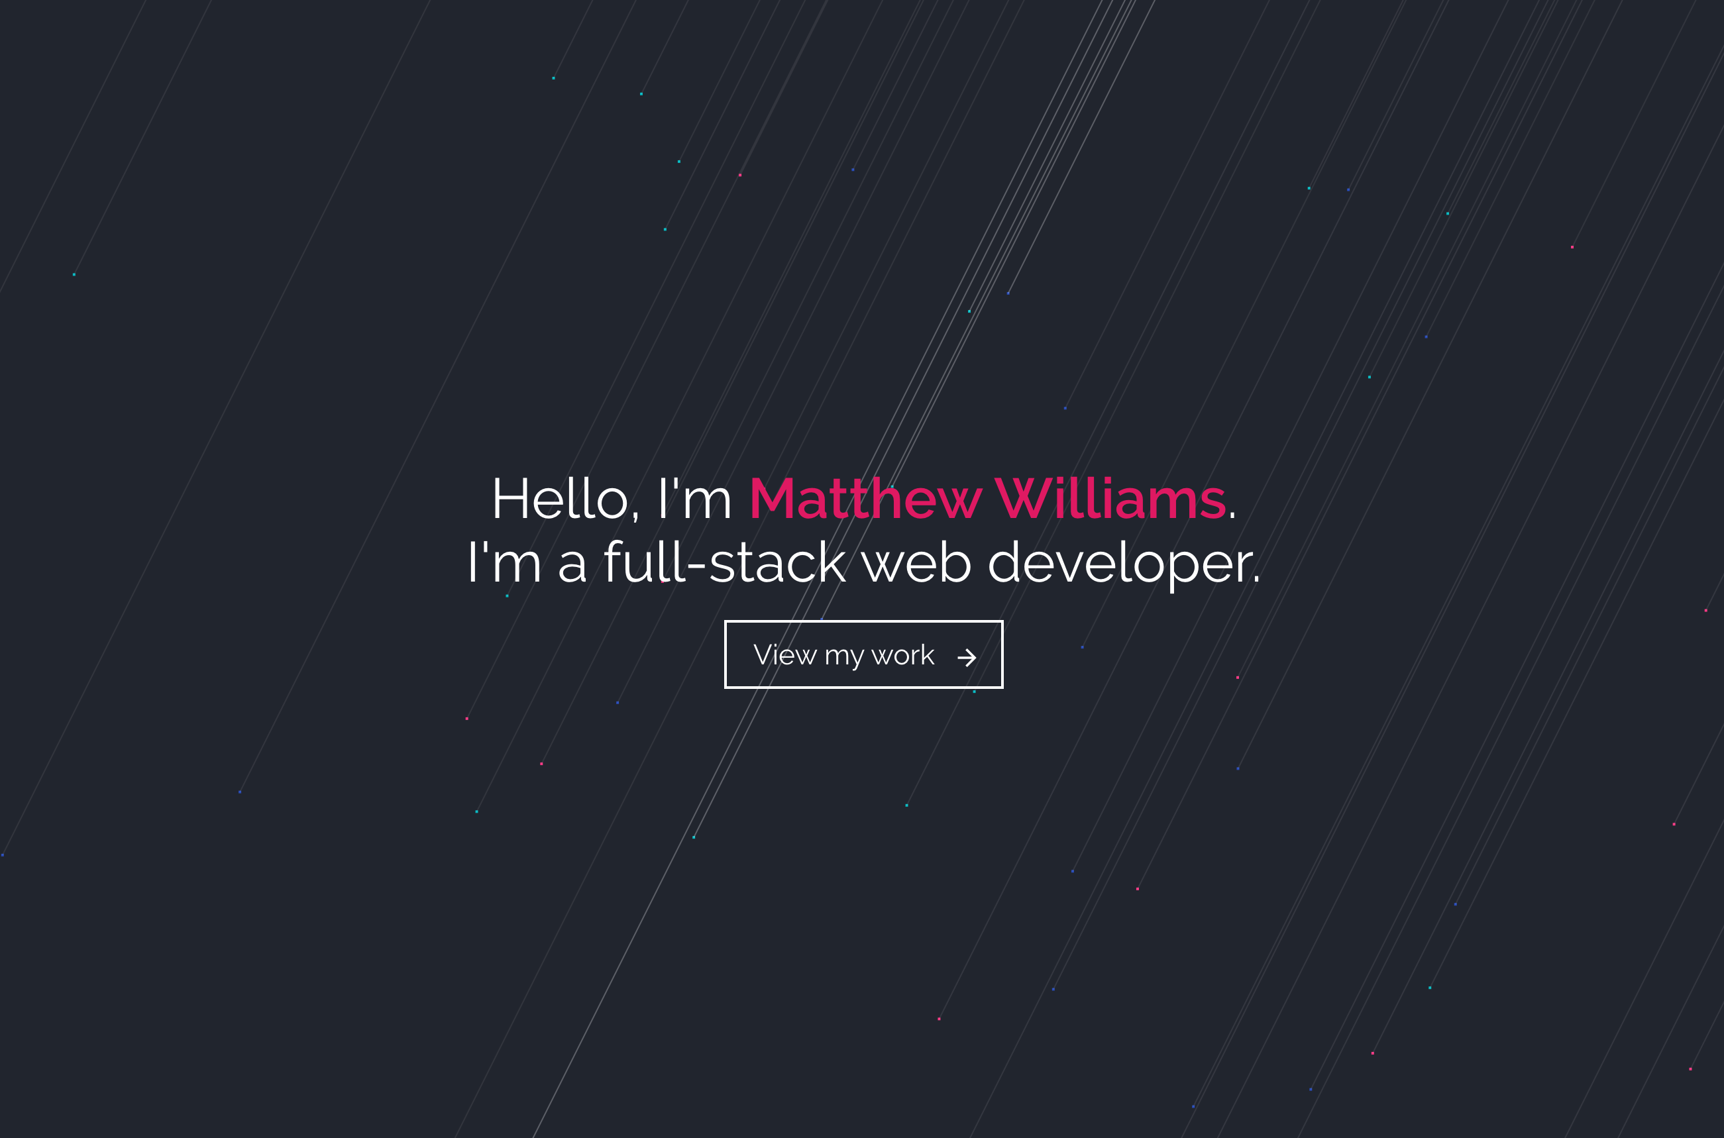

Slide 4

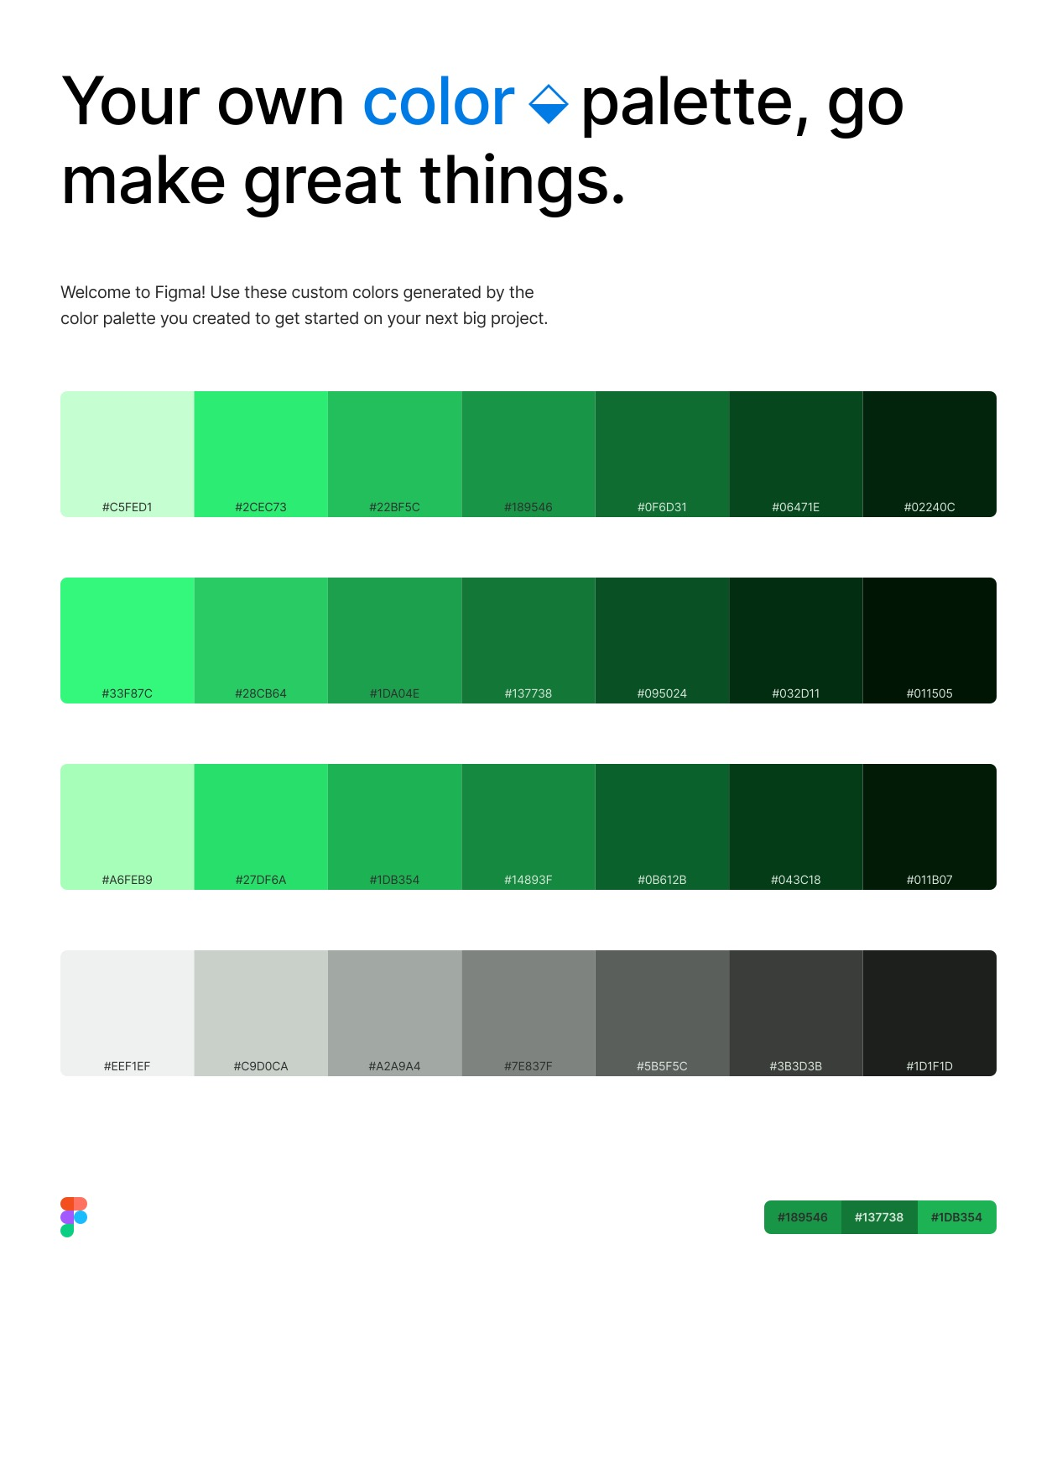
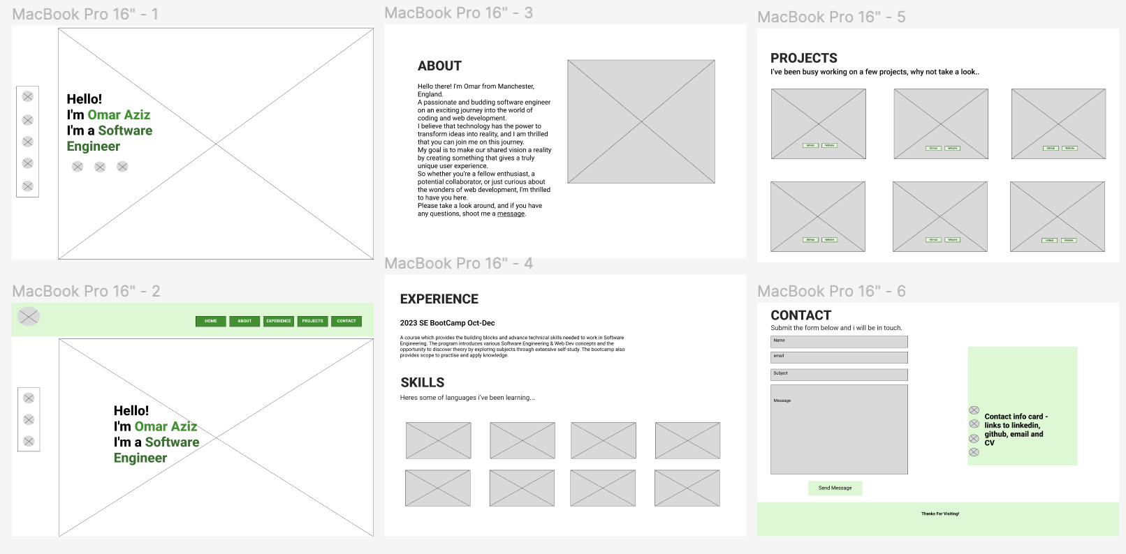
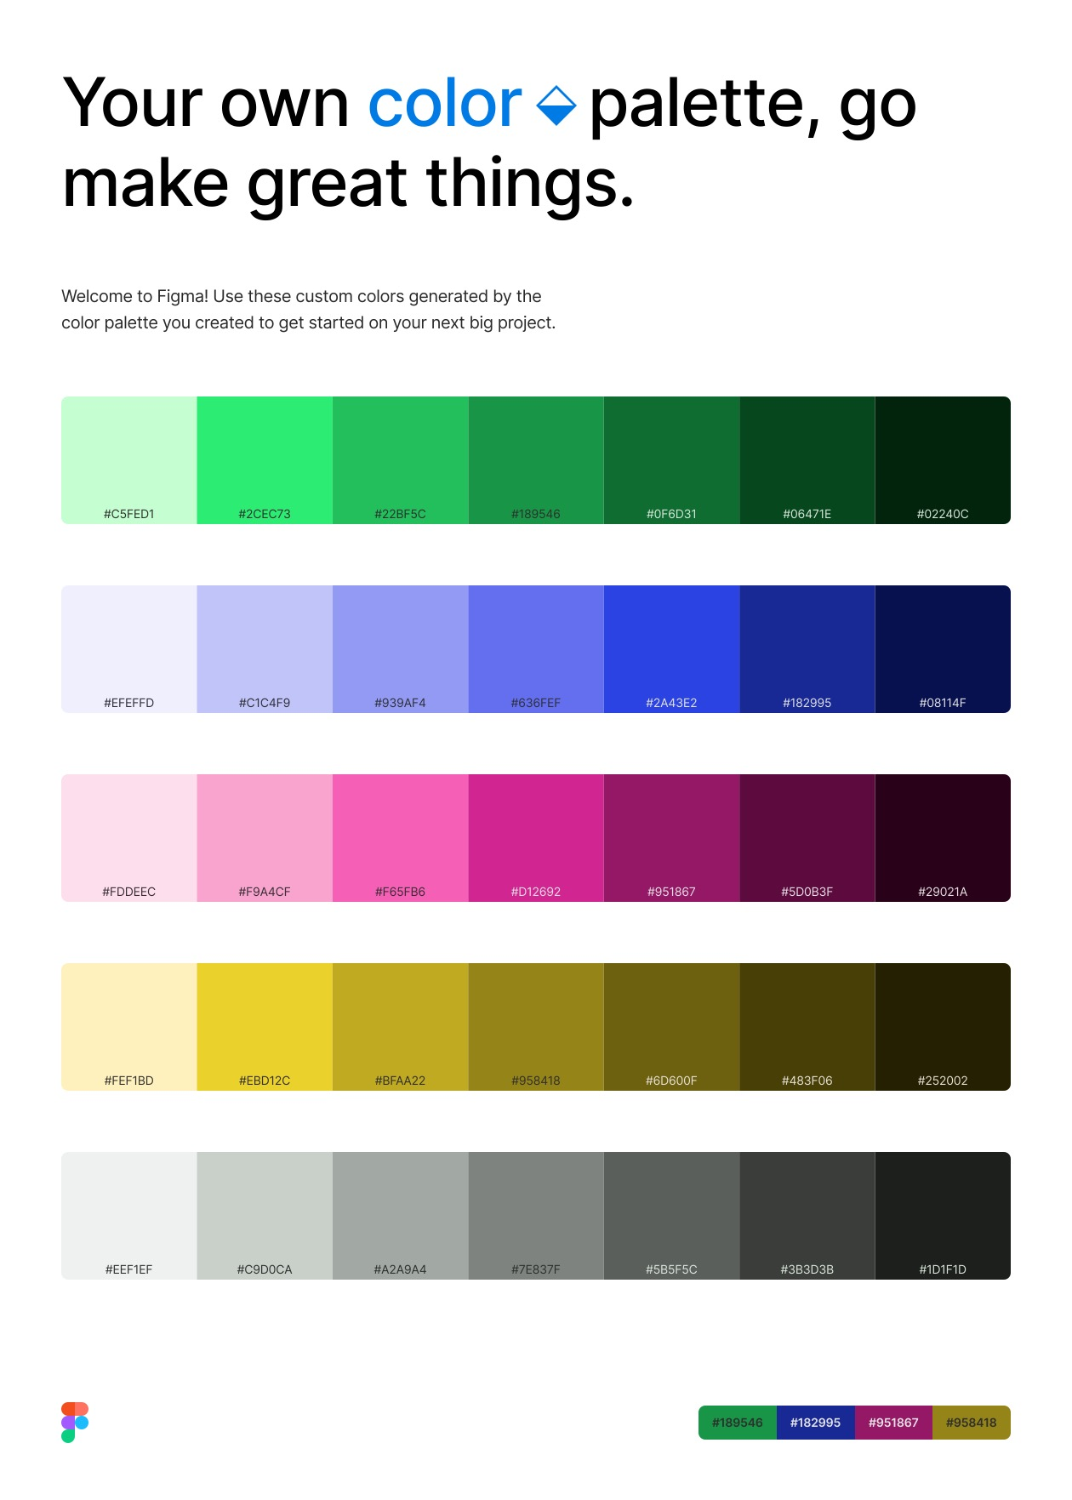
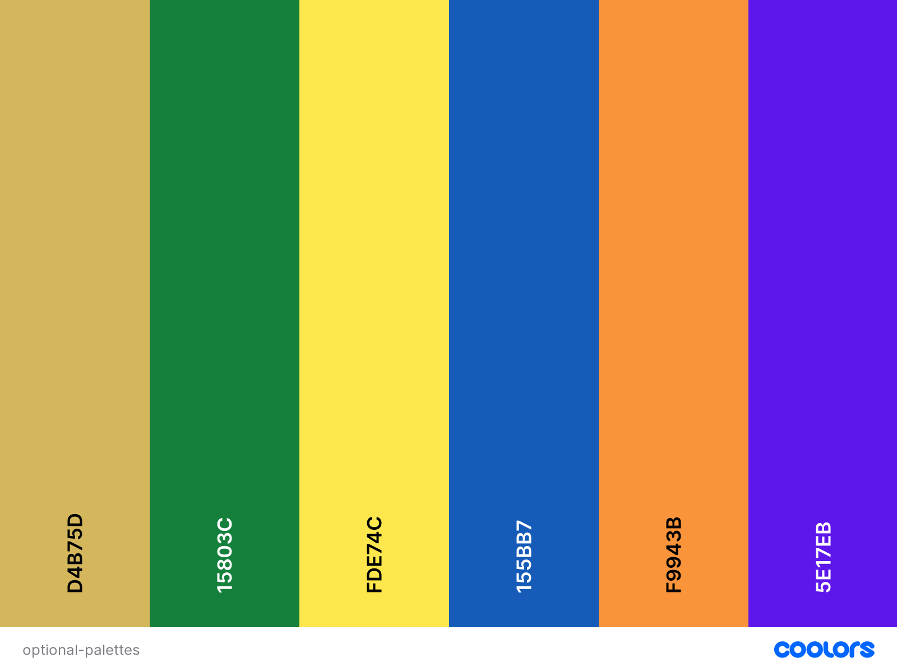
Figma – Take a look…

Slide 5
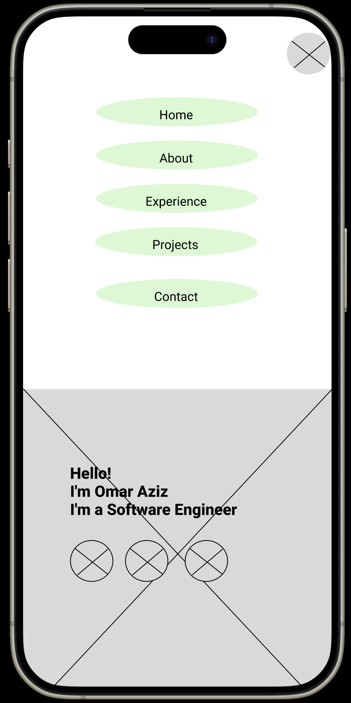
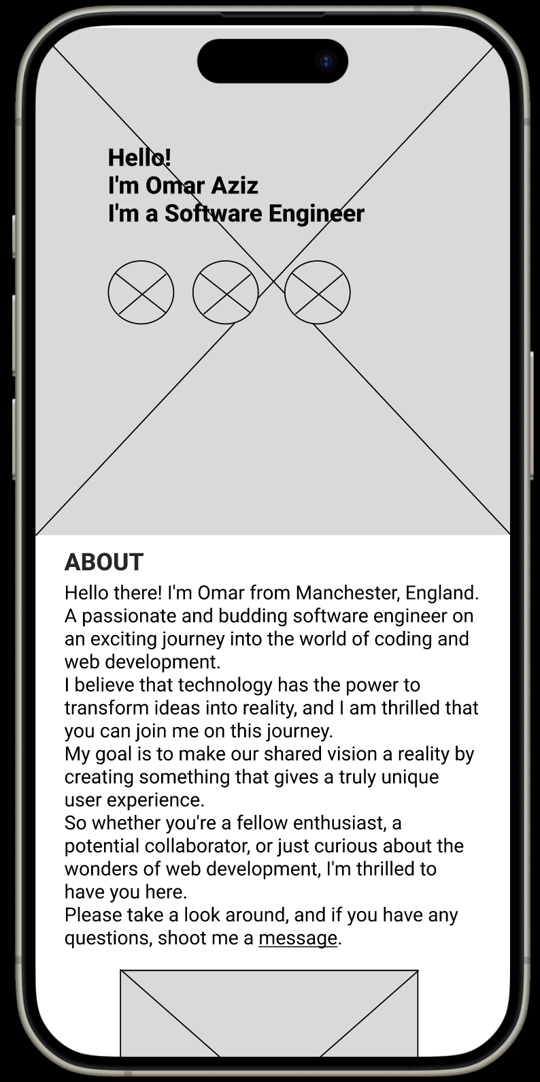
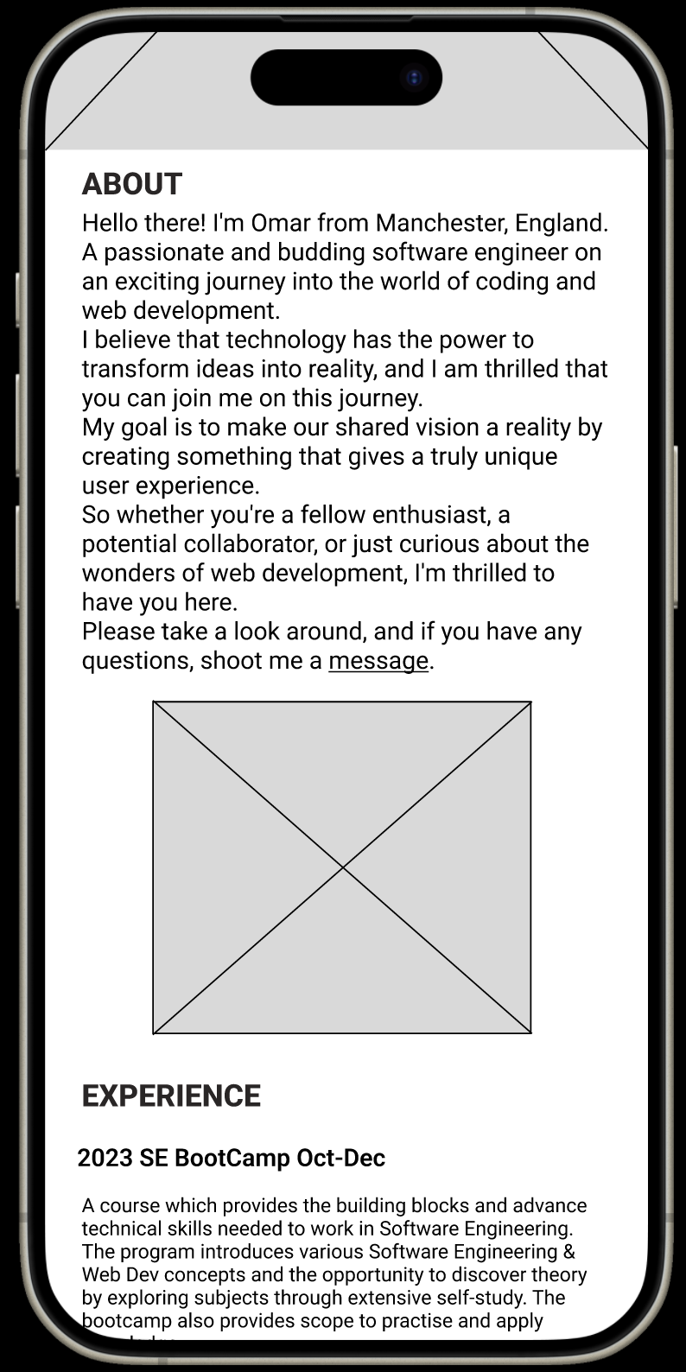
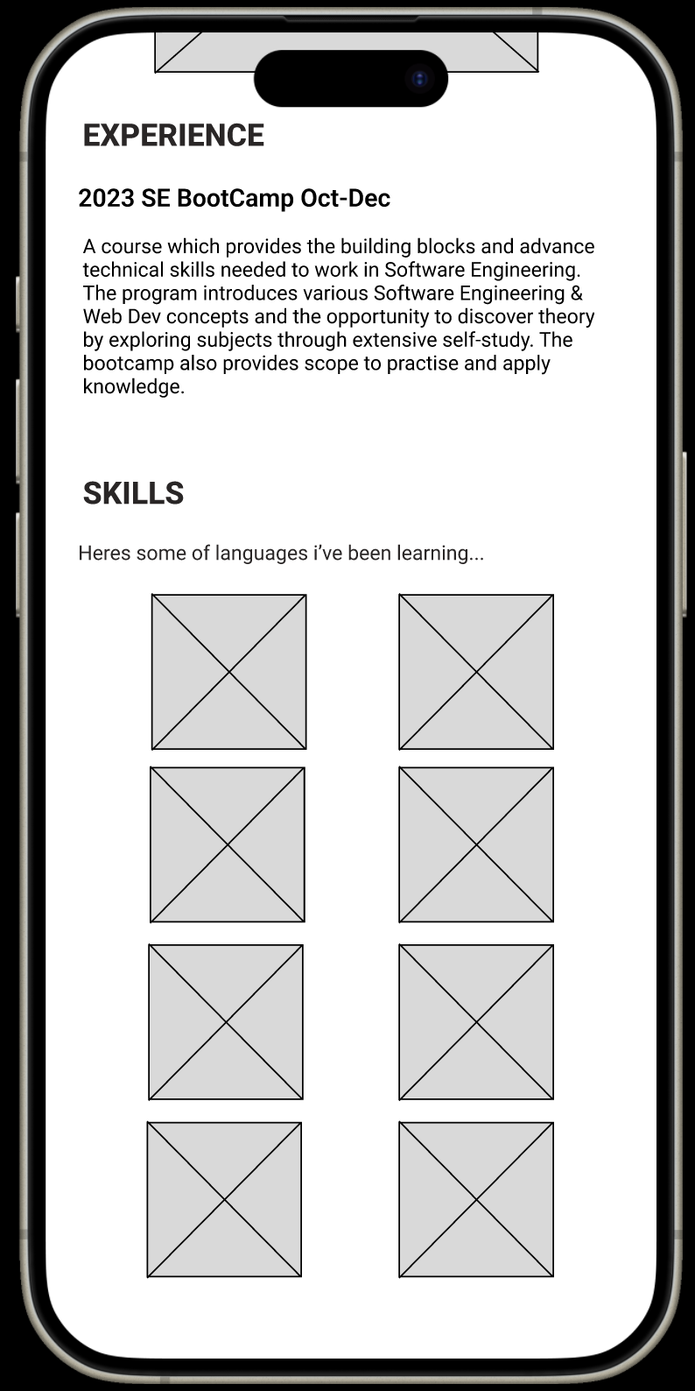

Slide 6
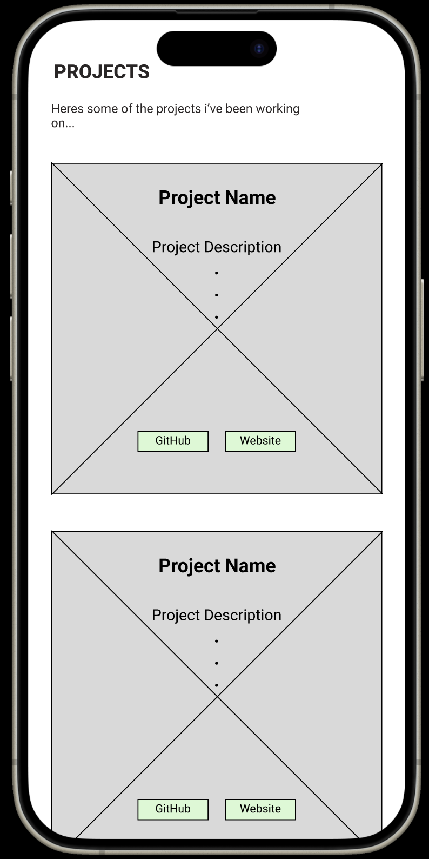
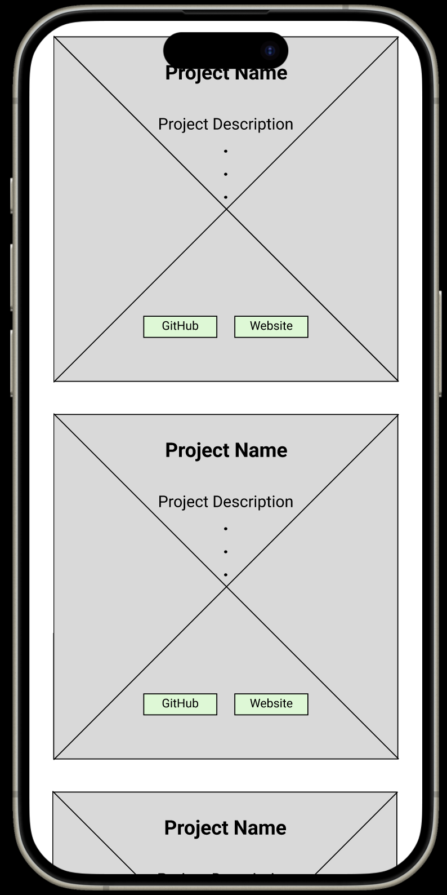
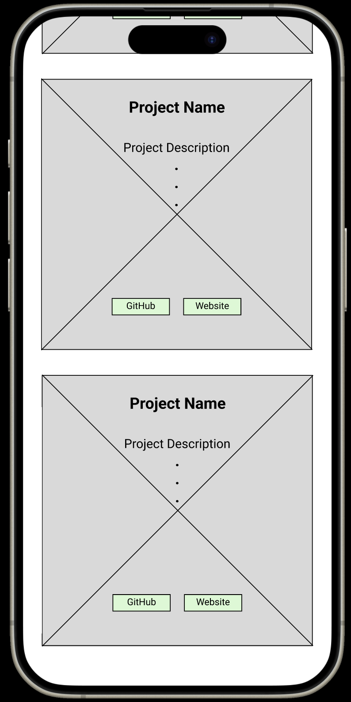
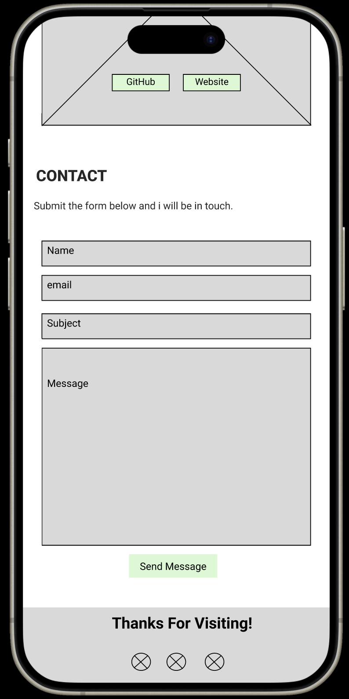

Slide 7







Deciding on the framework

Slide 8
React – Simple tool from Facebook – zero configuration, no need to mess around with build tools and has live loading. Perfect for beginners.
But no support for server-side rendering so not the best for future-proofing for SEO. Also, zero config means it hard to reconfigure in the future.
Next JS – One of the most popular tools. Allows for server side rendering perfect for SEO and web-crawlers in the future. Can also host on Vercel.
Better than react but a steeper learning curve than react. Syntax is a bit different.
Vite – Build tool and development server to allow for faster dev and build times. Flexible configurations so better than create react app but not as flexible as an application being built completely from scratch.

Slide 9
Bootstrap is used for creating responsive web and mobile applications whereas Tailwind CSS is used to create customised user interfaces.
Bootstrap | Tailwind CSS
It is one of the most popular HTML, CSS & JS framework used for creating responsive mobile first applications. | It is most popular CSS framework used for creating customized user interfaces.
It offers ready-made themes and templates. | It offers unique utility-first classes.
Applications created using Bootstrap are generally identical because it already has in-built templates for websites. | Application and websites created using Tailwind CSS are unique and flexible.
Bootstrap is a much older framework known for its responsiveness and efficiency. It saves a lot of time of the developers. | Tailwind CSS is a newer framework which is still improving and growing.
It requires large file size | It requires small file size
Famous companies using Bootstrap are Twitter, LinkedIn, Spotify, StackShare. | Famous companies using Tailwind CSS are MAKE IT, Superchat, Hashnode, Livestorm.

Slide 10
The Build..
Simple clean design.
A sleek hero page.
A functional navbar that remains fixed.
Easily accessible links to LinkedIn, GitHub and my CV.
An About section that’s not overdoing it.
An easy way to showcase my skills and experience
An functional and interactive Projects section with links to the code and the live web-apps.
A Contact section that make user interaction simple and flexible.
A footer with out the clutter.
A web address that makes sense.
LETS TAKE A LOOK – OMARAZIZ.CO.UK

Slide 11
The Challenges..
Learning Tailwind on the go.
Temptation to just follow tutorials but realising that it doesn’t help when trying to adapt code to my needs.
Trying to avoid using bootstrap templates so that I have greater customization.
Ensuring not to overcomplicate the website by forcing unnecessary animation and 3D functionality just for the sake of it.

Slide 12
The Learning..
Need to take more time to reflect on the work and the journey.
The code could be a lot cleaner. Could look to build an API for the projects and skills sections instead of using the array method.
Wishing I had used the global CSS document more.. Next time!
Google, YouTube and Chat GPT are my new best friends.

Slide 13
What's Next…
Work on the mobile sites for different screen sizes and orientations.
Work on the spacing of sections.
Look to add further functionality such as Dark Mode and exploring 3D element in the Hero section in place of the background image.
Research the SEO side and learn about how the analytics and google key words work.
Over the coming weeks I’m looking to build v2.0 with a more dynamic feel.
Also looking to build some other web-apps that showcase real-world application.

Slide 14
Resources
https://vitejs.dev/guide/
https://tailwindcss.com/
https://www.figma.com
https://www.invisionapp.com/inside-design/how-to-wireframe/
https://www.youtube.com/watch?v=6t_dYhXyYjI&t=1377s
https://coolors.co
https://fonts.googleapis.com/css2?family=Roboto:wght@400;500;700;900&family=Space+Mono:ital@0;1&display=swap
https://app.getform.io/
https://www.123-reg.co.uk/
https://www.youtube.com – for inspiration/ guides and tutorials

Slide 15
Thanks for listening!
Any Questions?

